Slide 1
On the Unusual Effectiveness of Automata in Quantitative Reasoning
Suguman Bansal
Department of Computer and Information Sciences
University of Pennsylvania

Slide 2
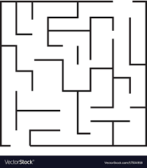
Reactive synthesis From Quantitative + Qualitative Specifications
Reach a destination
+
Maintain sufficient distance from adversary
Qualitative
Temporal Formula
Quantitative
Satisficing Goal
(Ensure cost of execution exceeds a threshold)
Notes:
Like specificatiosn that combine temporal goals with quantitative gaols.
Quant goals can reason about ……
Combination with temporal logics encode rich behaviors. E.g. – we can say the robot to satisfy a temporal logic while ensuring distance from the other agent.

Slide 3
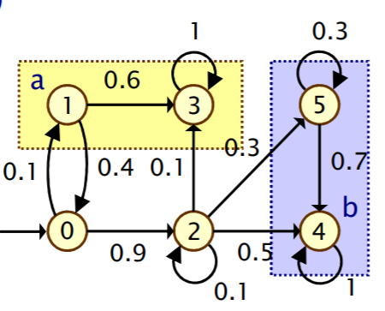
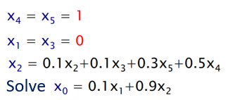
Separation of Techniques
Temporal
Goal
Satisficing
Goal
Unsound algorithms
[Kwiatkowska, Parker, Wiltsche; 2017] [Chatterjee et. al. 2017] [Wen, Ehlers, Topcu. 2015]
Automata-based methods
Numerical methods
Strategy
Notes:
Few algorithms for synthesis from this combination specification have been proposed.
These algoirthms employ two different techniques. For temporal specifications, autoamta-based methods are used. On

Slide 4
Solution Overview
Temporal
Goal
Satisficing
Goal
Comparison is fundamental
Cost of execution vs. fixed value
Cost of one execution vs. cost of another execution
Given, aggregate function $f:ℤ^{ω}→ℝ$
Can automata compare?
$f\left(A\right)≤f(B)$?
Can satisficing goals be represented by an automata?
Equivalent
automata
Strategy
Notes:
Add image

Slide 5
Comparator Automata [Bansal, Chaudhuri, Vardi. FoSSaCS 2018]
Parameters: Aggregate function $f:ℤ^{ω}→ℝ$,
Upper bound on weight sequences $μ>0$,
Equality or inequality relation $R∈\{≤, <, ≥, >,≠, =\}$
Comparator automata for $f, μ, R$ is a Büchi automaton that accepts
$(A,B)$iff $f\left(A\right) R f(B)$

Slide 6
Comparator Automata [Bansal, Chaudhuri, Vardi. FoSSaCS 2018]
Parameters: Aggregate function $f:ℤ^{ω}→ℝ$,
Upper bound on weight sequences $μ>0$,
Equality or inequality relation $R∈\{≤, <, ≥, >,≠, =\}$
Comparator automata for $f, μ, R$ is a Büchi automaton that accepts
$(A,B)$iff $f\left(A\right) R f(B)$
Discounted-sum
Approximation of Discounted-sum
$ω$-regular iff $d>1$is an integer
$ω$-regular

Slide 7
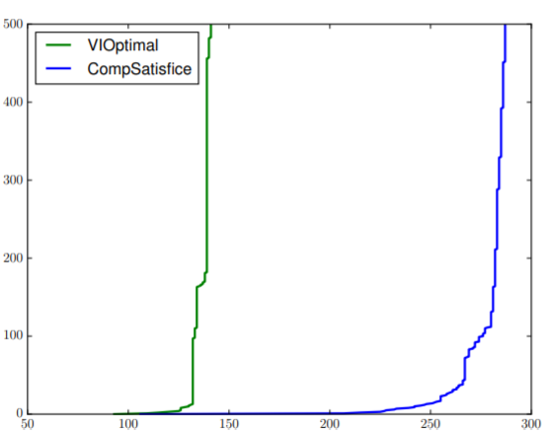
Solution Overview
[Bansal and Vardi. CAV 2019] [Bansal, Chatterjee, Vardi. TACAS 2021] [Bansal, Kavraki, Vardi, Wells. AAAI 2022]
Temporal
Goal
Satisficing
Goal
Algorithm is sound
Complexity of satisficing is $O(\left(\left|V\right|+\left|E\right|\right)⋅μ)$
vs Complexity of numerical methods is $O({\left|V\right|}^{2}⋅\left|E\right|)$
Comparator
automata
Equivalent
automata
Numerical Methods
Comparator
Strategy
Notes:
Add image

Slide 8
Automata-based Quantitative Reasoning
$$≥$$
$$+$$
$$\frac{a}{b}$$
Reduction of Quantitative to Qualitative
Reactive Synthesis with Quantitative Specifications
Quantitative
Verification
COMPARATOR
Probabilistic Systems,
Reinforcement Learning
Arithmetic
with Precision
Thank you, Moshe!
Notes:
To summarize the second part,

Slide 9
Back up

Slide 10
Satisficing via Comparators
Max-player wins if
Cost of plays exceeds $v$
$≡ DS\left(A,d\right)≥v ,$where $A is$ weight-sequence of a play
$≡(A, V)$is accepted by DS comparator for $≥$, where $V=\left\{v, 0,0….\right\}$
$≡$DS comparator for $≥$ is the winning condition
Theorem: For integer discount factors,
Satisficing problem reduces to solving a reachability/safety game
Solved in $O\left(\left(\left|V\right|+\left|E\right|\right))⋅μ⋅n\right)$ where threshold $v$ has an $n$-bit representation
Value iteration requires $Ω\left({\left|V\right|}^{2}\right)$ iterations
10

Slide 11
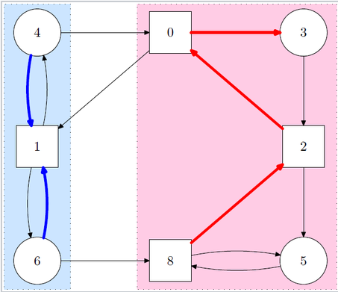
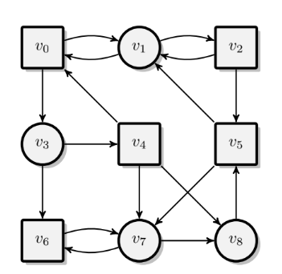
DS Games with Safety/Co-safety Comparators [Bansal, Chatterjee, and Vardi. 2020]
5
0
Integer $d>1$,
Threshold $v$
Maximum of absolute value of weights $μ$
Goal: Ensure that cost play $R v$
Deterministic safety or co-safety comparator for $d, μ, R$ accepts $A$ iff $DS\left(A\right) R v$
-1
-3
2
Synchronized
product with
1
-2
1
4
3
Product game has safety or co-safety winning condition
Theorem: For integer discount factors,
1. DS games reduce to a game with safety/co-safety winning condition
2. DS games solved in $O\left(\left(\left|V\right|+\left|E\right|\right)⋅μ⋅n\right)$ where threshold $v$ has an $n$-bit representation
Value iteration requires $Ω\left({\left|V\right|}^{2}\right)$ iterations
Notes:
Add a diagram for comparator

Slide 12
Comparison using Automata [Bansal, Chaudhuri, and Vardi. FoSSaCS 2018] [Bansal and Vardi. CAV 2019]
Given, discount factor $d>1$, Comparator accepts a $(A,B)$iff $DS\left(A,d\right)≤DS(B,d)$
For integer discount factors,
$DS\left(A,d\right)=a_{0}+\frac{a_{1}}{d}+\frac{a_{2}}{d^{2}}+…= {\left(a_{0}.a_{1}a_{2}…\right)}_{d}=A_{d}$
$DS\left(A,d\right)≤ DS(B,d) \text{iff} A_{d}≤B_{d}$
Is there $C$ s.t. $DS\left(C,d\right)=B_{d}−A_{d}≥0$?
Caveat: $a_{i}≥d$ and -ve
Caveat: Difference of infinite sequences?

Slide 13
Core Insight
Consider ($d=10$)
Most significant
Least significant
X
A 5 13 6
C + 0 8 6
B
Notes:
The second insight is w.r.t.determining the difference sequnce C.
To determine the difference between B and A, we perform the same basic operations for computing difference between two numbers, only difference is that instead of moving from the least significant to the most significant digit, we move from the most significant to the least significant element.
For this we guess the difference sequence, and carry bit sequence in a systematic manner by following these two equations.
What we can prove, is that when DS(A) < DS(B) then using the equations that I showed you on the previous slide, we can always find sequnce diference sequence C and carry bit sequecne X.
More complex when
Discount-factor is not integer
Elements of sequences A, B can be greater than discount-factor

Slide 14
Core Insight
Consider ($d=10$)
Most significant
Least significant
X 1 0
A 5 13 6
C + 0 8 6
B 2
$$i>0, { a}_{i} +{ c}_{i} +x_{i}=b_{i}+d⋅x_{i−1}$$
Notes:
The second insight is w.r.t.determining the difference sequnce C.
To determine the difference between B and A, we perform the same basic operations for computing difference between two numbers, only difference is that instead of moving from the least significant to the most significant digit, we move from the most significant to the least significant element.
For this we guess the difference sequence, and carry bit sequence in a systematic manner by following these two equations.
What we can prove, is that when DS(A) < DS(B) then using the equations that I showed you on the previous slide, we can always find sequnce diference sequence C and carry bit sequecne X.
More complex when
Discount-factor is not integer
Elements of sequences A, B can be greater than discount-factor

Slide 15
Core Insight
Consider ($d=10$)
Most significant
Least significant
X 2 1 0
A 5 13 6
C + 0 8 6
B 2 2
$$i>0, { a}_{i} +{ c}_{i} +x_{i}=b_{i}+d⋅x_{i−1}$$
Notes:
The second insight is w.r.t.determining the difference sequnce C.
To determine the difference between B and A, we perform the same basic operations for computing difference between two numbers, only difference is that instead of moving from the least significant to the most significant digit, we move from the most significant to the least significant element.
For this we guess the difference sequence, and carry bit sequence in a systematic manner by following these two equations.
What we can prove, is that when DS(A) < DS(B) then using the equations that I showed you on the previous slide, we can always find sequnce diference sequence C and carry bit sequecne X.
More complex when
Discount-factor is not integer
Elements of sequences A, B can be greater than discount-factor

Slide 16
Core Insight
Consider ($d=10$)
Most significant
Least significant
X 2 1 0
A 5 13 6
C + 0 8 6
B 7 2 2
$$i=0, a_{0}+c_{0}+x_{0}=b_{0}$$
$$i>0, { a}_{i} +{ c}_{i} +x_{i}=b_{i}+d⋅x_{i−1}$$
Notes:
The second insight is w.r.t.determining the difference sequnce C.
To determine the difference between B and A, we perform the same basic operations for computing difference between two numbers, only difference is that instead of moving from the least significant to the most significant digit, we move from the most significant to the least significant element.
For this we guess the difference sequence, and carry bit sequence in a systematic manner by following these two equations.
What we can prove, is that when DS(A) < DS(B) then using the equations that I showed you on the previous slide, we can always find sequnce diference sequence C and carry bit sequecne X.
More complex when
Discount-factor is not integer
Elements of sequences A, B can be greater than discount-factor

Slide 17
Core Insight
Consider ($d=10$)
Most significant
Less significant
X
A 5 13 6 0 0 0 ….
C
B 7 2 2 0 0 0 ….
$$i=0, a_{0}+c_{0}+x_{0}=b_{0}$$
$$i>0, { a}_{i} +{ c}_{i} +x_{i}=b_{i}+d⋅x_{i−1}$$
Notes:
The second insight is w.r.t.determining the difference sequnce C.
To determine the difference between B and A, we perform the same basic operations for computing difference between two numbers, only difference is that instead of moving from the least significant to the most significant digit, we move from the most significant to the least significant element.
For this we guess the difference sequence, and carry bit sequence in a systematic manner by following these two equations.
What we can prove, is that when DS(A) < DS(B) then using the equations that I showed you on the previous slide, we can always find sequnce diference sequence C and carry bit sequecne X.
More complex when
Discount-factor is not integer
Elements of sequences A, B can be greater than discount-factor

Slide 18
Core Insight
Consider ($d=10$)
Most significant
Less significant
X 2
A 5 13 6 0 0 0 ….
C + 0
B 7 2 2 0 0 0 ….
$$i=0, a_{0}+c_{0}+x_{0}=b_{0}$$
$$i>0, { a}_{i} +{ c}_{i} +x_{i}=b_{i}+d⋅x_{i−1}$$
Notes:
The second insight is w.r.t.determining the difference sequnce C.
To determine the difference between B and A, we perform the same basic operations for computing difference between two numbers, only difference is that instead of moving from the least significant to the most significant digit, we move from the most significant to the least significant element.
For this we guess the difference sequence, and carry bit sequence in a systematic manner by following these two equations.
What we can prove, is that when DS(A) < DS(B) then using the equations that I showed you on the previous slide, we can always find sequnce diference sequence C and carry bit sequecne X.
More complex when
Discount-factor is not integer
Elements of sequences A, B can be greater than discount-factor

Slide 19
Core Insight
Consider ($d=10$)
Most significant
Less significant
X 2 1
A 5 13 6 0 0 0 ….
C + 0 8
B 7 2 2 0 0 0 ….
$$i=0, a_{0}+c_{0}+x_{0}=b_{0}$$
$$i>0, { a}_{i} +{ c}_{i} +x_{i}=b_{i}+d⋅x_{i−1}$$
Notes:
The second insight is w.r.t.determining the difference sequnce C.
To determine the difference between B and A, we perform the same basic operations for computing difference between two numbers, only difference is that instead of moving from the least significant to the most significant digit, we move from the most significant to the least significant element.
For this we guess the difference sequence, and carry bit sequence in a systematic manner by following these two equations.
What we can prove, is that when DS(A) < DS(B) then using the equations that I showed you on the previous slide, we can always find sequnce diference sequence C and carry bit sequecne X.
More complex when
Discount-factor is not integer
Elements of sequences A, B can be greater than discount-factor

Slide 20
Core Insight
Consider ($d=10$)
Most significant
Less significant
X 2 1 0
A 5 13 6 0 0 0 ….
C + 0 8 6
B 7 2 2 0 0 0 ….
$$i=0, a_{0}+c_{0}+x_{0}=b_{0}$$
$$i>0, { a}_{i} +{ c}_{i} +x_{i}=b_{i}+d⋅x_{i−1}$$
Notes:
The second insight is w.r.t.determining the difference sequnce C.
To determine the difference between B and A, we perform the same basic operations for computing difference between two numbers, only difference is that instead of moving from the least significant to the most significant digit, we move from the most significant to the least significant element.
For this we guess the difference sequence, and carry bit sequence in a systematic manner by following these two equations.
What we can prove, is that when DS(A) < DS(B) then using the equations that I showed you on the previous slide, we can always find sequnce diference sequence C and carry bit sequecne X.
More complex when
Discount-factor is not integer
Elements of sequences A, B can be greater than discount-factor

Slide 21
Core Insight
Consider ($d=10$)
Most significant
Less significant
X 2 1 0 0 0 0 ….
A 5 13 6 0 0 0 ….
C + 0 8 6 0 0 0 ….
B 7 2 2 0 0 0 ….
}
$$i=0, a_{0}+c_{0}+x_{0}=b_{0}$$
$$DS(A,d)+DS(C,d)=DS(B,d)$$
$$i>0, { a}_{i} +{ c}_{i} +x_{i}=b_{i}+d⋅x_{i−1}$$
Notes:
The second insight is w.r.t.determining the difference sequnce C.
To determine the difference between B and A, we perform the same basic operations for computing difference between two numbers, only difference is that instead of moving from the least significant to the most significant digit, we move from the most significant to the least significant element.
For this we guess the difference sequence, and carry bit sequence in a systematic manner by following these two equations.
What we can prove, is that when DS(A) < DS(B) then using the equations that I showed you on the previous slide, we can always find sequnce diference sequence C and carry bit sequecne X.
More complex when
Discount-factor is not integer
Elements of sequences A, B can be greater than discount-factor

Slide 22
Comparison using Automata [Bansal, Chaudhuri, and Vardi. FoSSaCS 2018] [Bansal and Vardi. CAV 2019]
Given, discount factor $d>1$, Comparator accepts $(A,B)$iff $DS\left(A,d\right)≤DS(B,d)$
For integer discount factors,
$DS\left(A,d\right)=a_{0}+\frac{a_{1}}{d}+\frac{a_{2}}{d^{2}}+…= {\left(a_{0}.a_{1}a_{2}…\right)}_{d}=A_{d}$
$DS\left(A,d\right)≤ DS(B,d) \text{iff} A_{d}≤B_{d}$
Is there $C$ s.t. $DS\left(C,d\right)=B_{d}−A_{d}≥0$?
Non-determinism in arithmetic from most to lesser significant digits
Finitely many possibilities for $x_{i}$-s and $c_{i}$-s
Caveat: $a_{i}≥d$ and -ve
Caveat: Difference of infinite sequences?
Theorem [Bansal, Chaudhuri, and Vardi. FoSSaCS 2018] [Bansal and Vardi. CAV 2019]
Comparator is an (Büchi) automata iff the discount factor is an integer

Slide 23
Approximate comparison using Automata [Bansal, Kavraki, Vardi, Wells. AAAI 2022]
For non-integer discount factor $d$,
Given, approximation factor $ε<1$,
If approximate comparator accepts $(A,B)$then $DS\left(A,d\right)≤DS(B,d)$
If approximate comparator rejects $(A,B)$then $DS\left(A,d\right)>DS\left(B,d\right)+d⋅ε$
Theorem [Bansal, Kavraki, Vardi, Wells. AAAI 2022]
Approximate Comparator is an (Büchi) automata

Slide 24
Quantitative Graph Game
2
1
Two-player graph game with weights on edges
Plays begin in initial state
From each state, its player choses the next state
Cost of a play
Discounted-sum of its weight sequence
For weight sequence $A$ and discount factor $d>1$,
$DS\left(A,d\right)=A\left[0\right]+\frac{A\left[1\right]}{d}+\frac{A\left[2\right]}{d^{2}}+…$
$$v_{0}$$
$$v_{1}$$
-3
5
-1
$$v_{2}$$
$$v_{3}$$
0
System
chooses
Environment
chooses

Slide 25
Reactive synthesis From Temporal + Satisficing Specifications
Given,
Quantitative graph game, and
Specification
Temporal formula
Satisficing goal: Given threshold value $t$, ensure cost of plays exceeds the threshold
Generate a system strategy$f:V^{∗}V_{s}→V$ that satisfies specification on all execution

Slide 26
Reactive synthesis From Temporal + Satisficing Specifications
1
-1
0
Given,
Quantitative graph game, and
Specification
Temporal formula: Visit state $v_{1}$
Satisficing goal: Given threshold value $t$, ensure cost of plays exceeds the threshold: $t=0.5$
Generate a system strategy$f:V^{∗}V_{s}→V$ that satisfies specification on all execution
$$v_{0}$$
$$v_{1}$$
0
System
chooses
Environment
chooses
1. From $v_{0}$ choose $v_{0}$
2. From $v_{0}$ choose $v_{1}$
From $v_{0}$ choose $v_{0}$ initially, then choose $v_{1}$

